Slide 1
CSCI 576- Multimedia System Design Project
Vedanshee Trivedi and Kübra Keskin

Slide 2
Approach 1: Single-Pass Stitching Approach
Sample and Downscale: Read every Nth frame (step) and resize by (down)
Initialize Panorama: First sampled frame becomes the base pano
Iterative Stitch Loop:
Feature Extraction: ORB + SIFT on current pano and next frame
Descriptor Matching: knnMatch + ratio test (Hamming for ORB, L2 for SIFT)
Homography Estimation: RANSAC 4px threshold
Warp and blend: Compute union canvas via perspective Transform + translation and feather-blend for distance transforms
Update Panorama: re-extract features on the blended pano

Slide 3
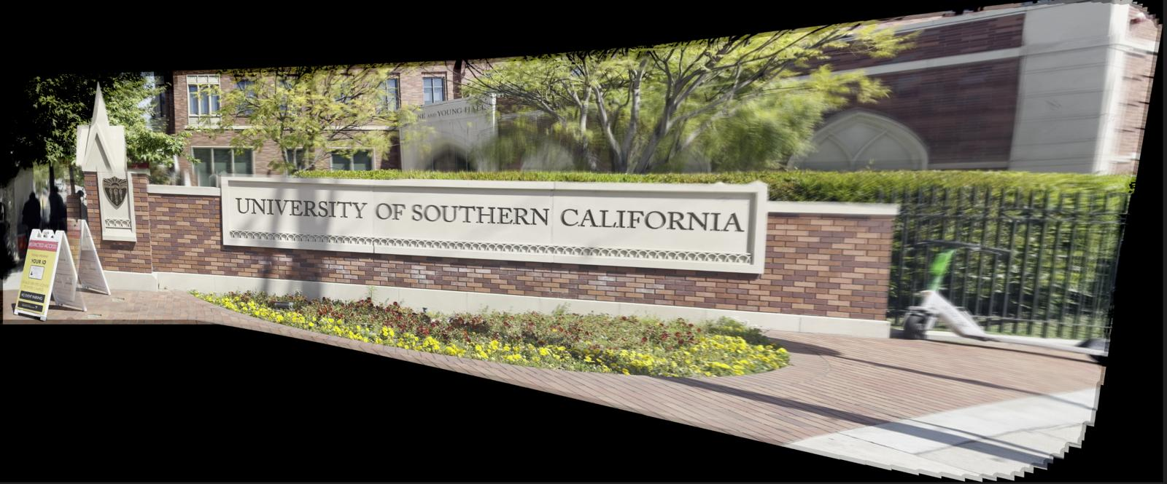
Approach 1: Single-Pass Stitching Approach
Step size: 5 and down value: 0.5 (Processing Time: 12 min)

Slide 4
Approach 2: Batch-Wise Stitching
Sample & Downscale: Skip every Nth frame (step) and resize (down)
Form Batches: Group into M frames (batch-size), give full/partial batches
Parallel Stitch:
Each batch creates a mini-panorama via ORB+SIFT detection (BFMatcher and Ratio Test)
Homography (RANSAC), warping, and blending
Merge Results: Sequentially stitch batch panoramas into the final image

Slide 5
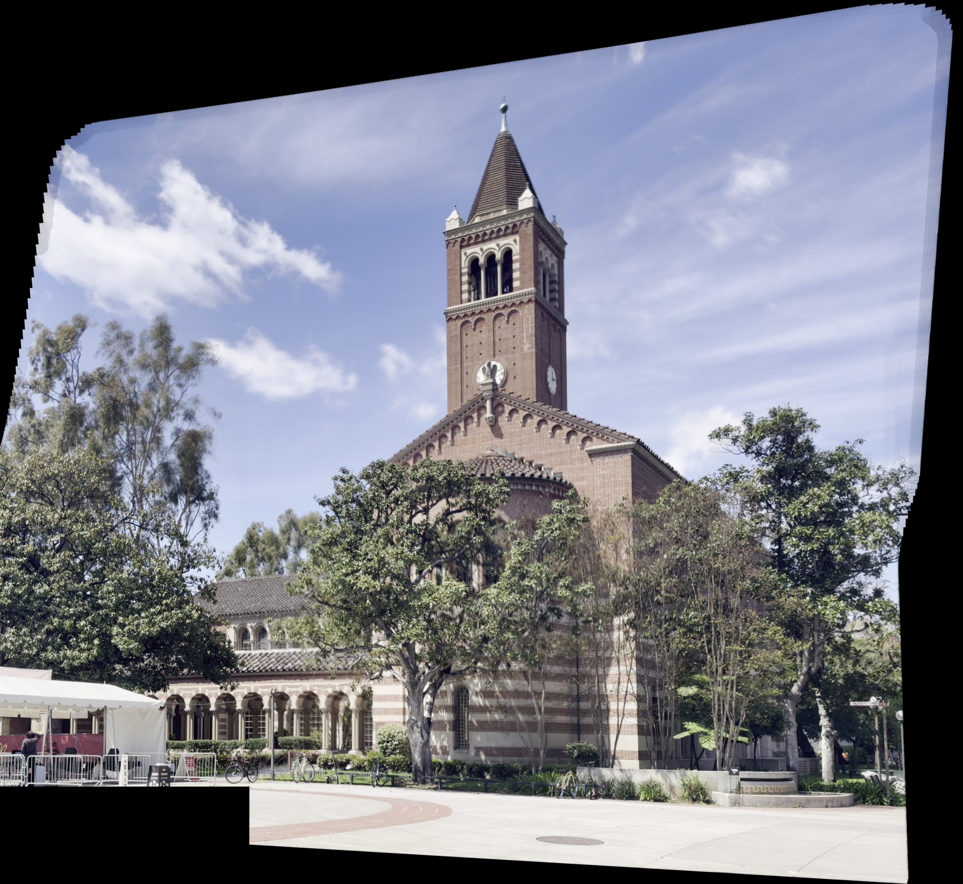
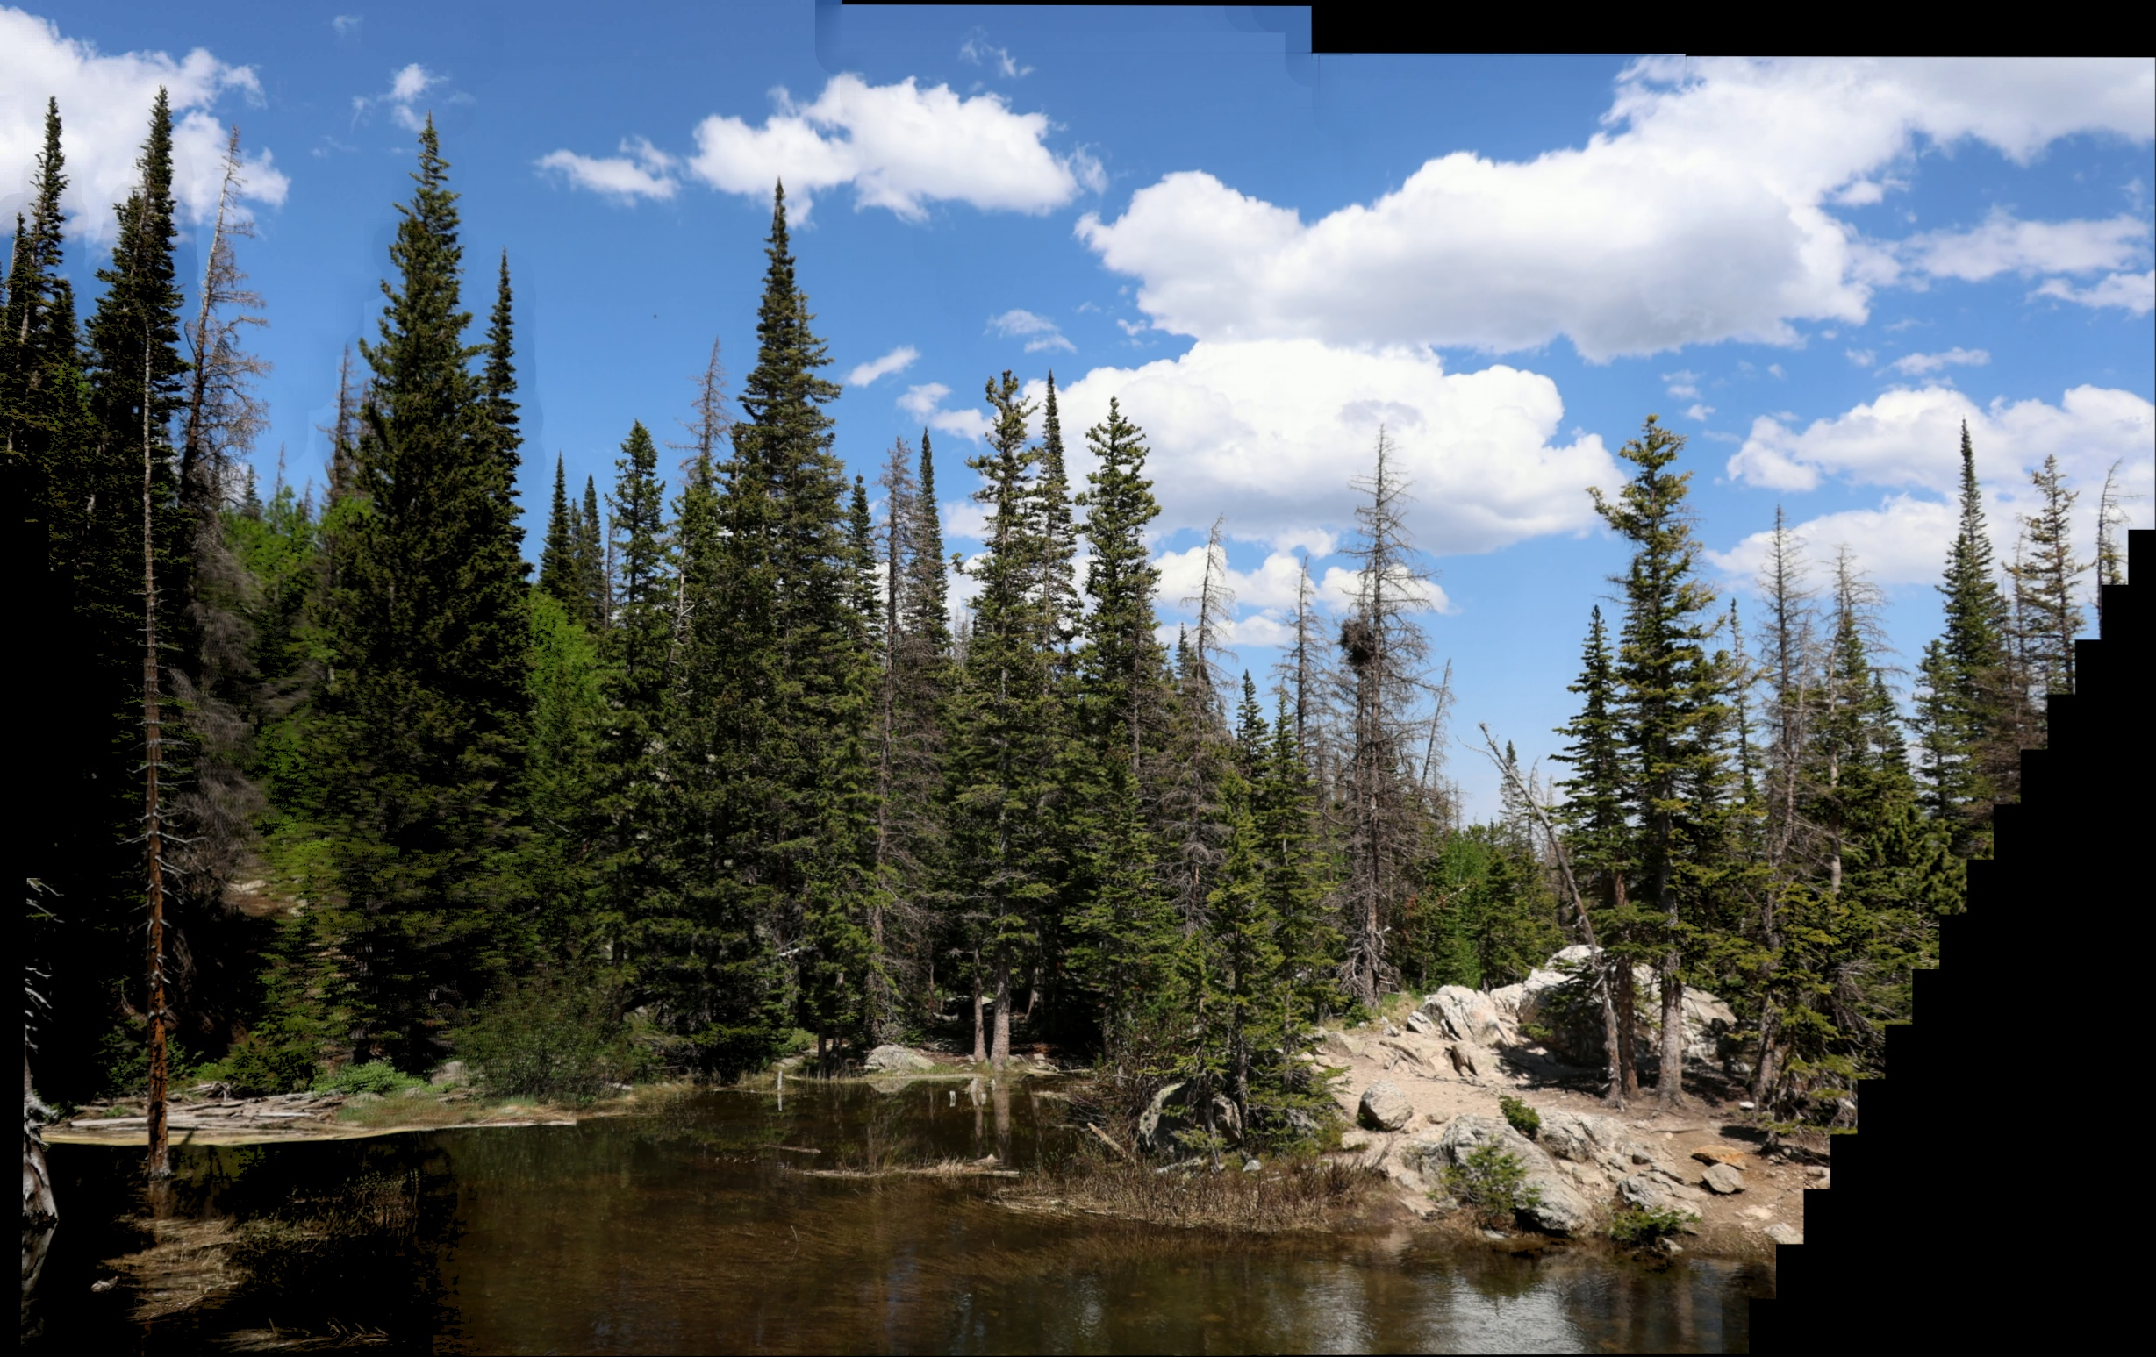
Approach 2: Batch-Wise Stitching
Batch-size:30, step:5, scale:0.5- Processed 4 batches of 30 frames each (2 min processing time)
Batch-size:30, step:5, scale:0.5- Processed 4 batches of 30 frames each (5.6 min processing time)

Slide 6
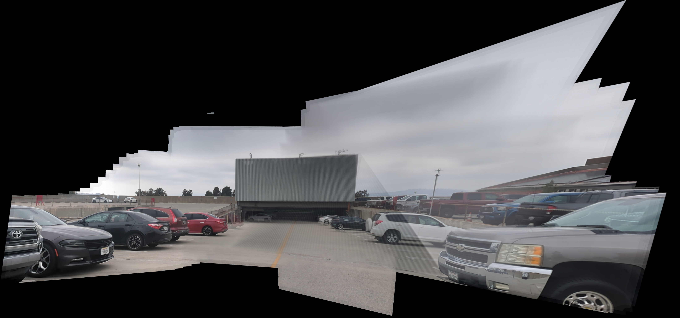
Approach 2: Batch-Wise Stitching on Dataset
Batch-size:10, step:5,down:0.5- takes 35 seconds to process

Slide 7
Approach 3: Sequential Multi-Video Stitching
Adaptive frame sampling: based on heuristics motion calculation
Video 0: frame by frame, other videos: local ROI matching
Precompute canvas size with computing all homographies quickly first
Blending: Uses a binary mask so overlapping frames average equally
Features: ORB + SIFT
Local ROI matching: around previous frame’s location

Slide 8
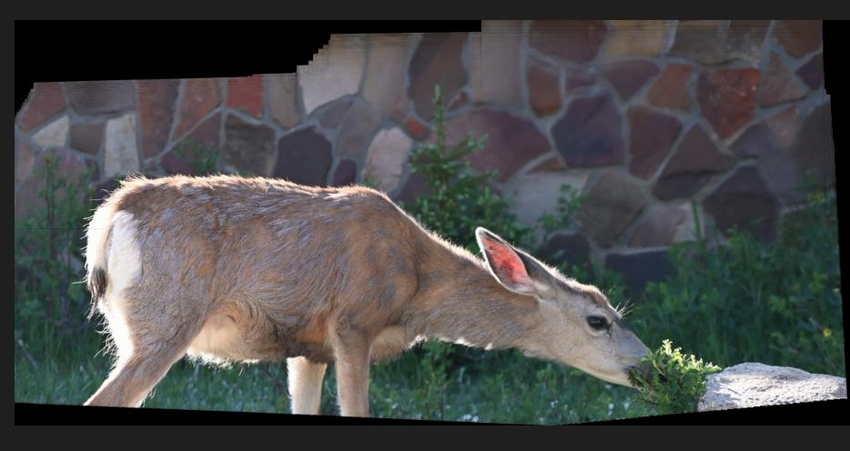
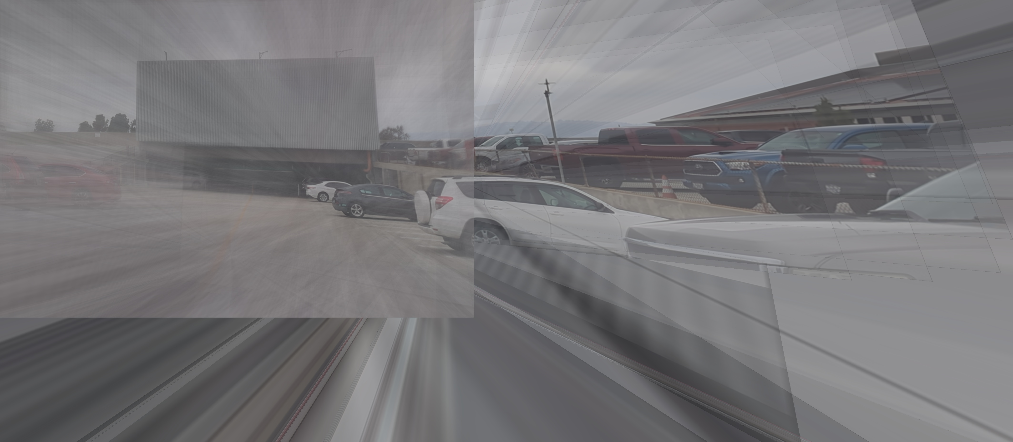
Approach 3: Sequential Multi-Video Stitching
The approach worked well for the deer video on the left (overlapping videos)
but performed poorly for not much overlapping video start

Slide 9
Approach 4: Individual Video Stitching + Merging All Video Panoramas
Adaptive frame sampling: based on heuristics motion calculation
If given clips do not overlap back-to-back, create a panorama for individual clips and then combine them
Check if homography H is bad:
Determinant too small
Extreme values in H matrix
(Or better version: condition number of H matrix)
Fallback logic: If H bad -> reuse last valid H, if still bad -> skip frames, after couple of skips -> stop processing frames
Canvas size clamping: Computes global min/max of all warped corners and then clamps to a max size
Blending: Gaussian weight map per frame so overlapping regions blend smoothly

Slide 10
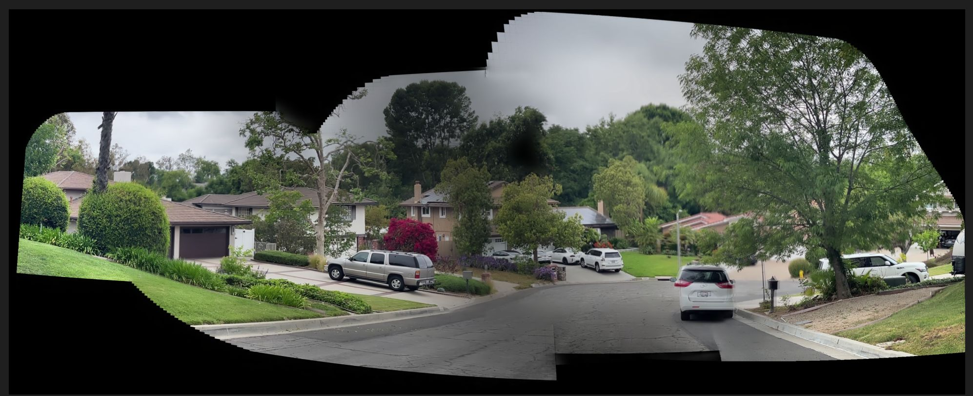
Approach 4: Individual Video Stitching + Merging All Video Panoramas
Individually stitched and combined: Took 4 min to process

Slide 11
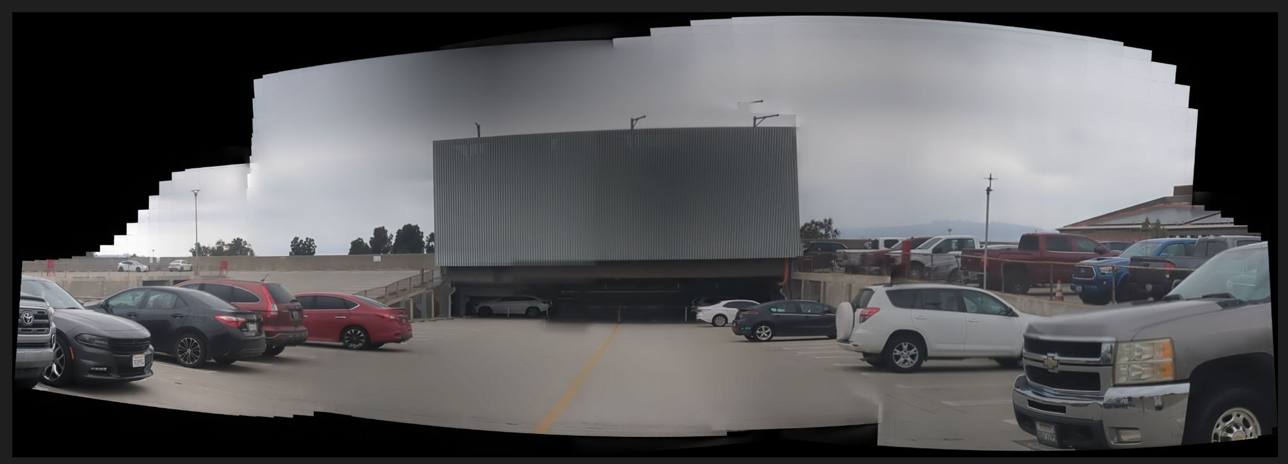
Approach 4: Individual Video Stitching + Merging All Video Panoramas
Individually stitched and combined: Took 1 min to process

